Slide 1
Meeting Week 13
Last week summary
  Simulation
  Augmentation
Simulation of parameter recovery
Question 1
Question 2
Outline ToDo next week

Slide 2
Last week summary
Simulation
  Generated data of the system, detuned the model and tried to recover the initial parameters with which the data is generated
Augmentation
  Addition of additional state

Slide 3



Slide 4
Note:
Picture is not fully accurate, we define the mass as the relative displacement from mh currently
Will need to add offset

Slide 5

Lagrange-Euler - Garcia

Slide 6

Lagrange-Euler - Garcia

Slide 7
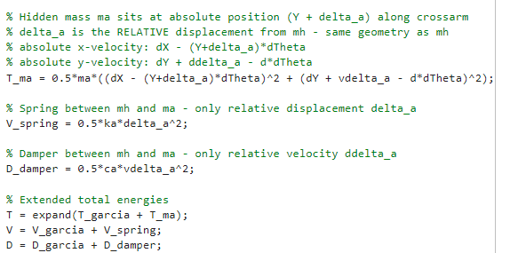
Lagrange-Euler – Additional state
Notes:
Why $T_{ma}$Has No $J_{a}$Term
$m_{a}$is modeled as a point mass — it has no rotational inertia about its own center of mass.
Linear spring: linear spring potential energy
Jan also has linear spring…?

Slide 8
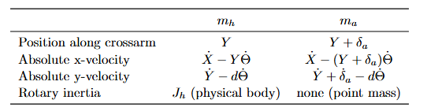
Lagrange-Euler – Additional state
Notes:
Why $T_{ma}$Has No $J_{a}$Term
$m_{a}$is modeled as a point mass — it has no rotational inertia about its own center of mass.
Linear spring: linear spring potential energy
Jan also has linear spring…?

Slide 9
Lagrange-Euler – Additional state
Notes:
Why $T_{ma}$Has No $J_{a}$Term
$m_{a}$is modeled as a point mass — it has no rotational inertia about its own center of mass.
Linear spring: linear spring potential energy
Jan also has linear spring…?

Slide 10
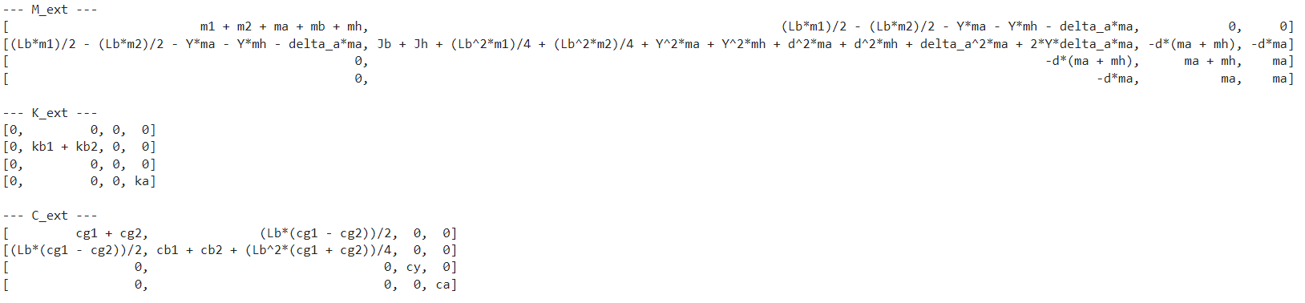
Symbolic toolbox result
4th row and 4th column is the addition of the additional state delta_a

Slide 11
Simulation
Trajectories
Previous results
Changes based on these results

Slide 12
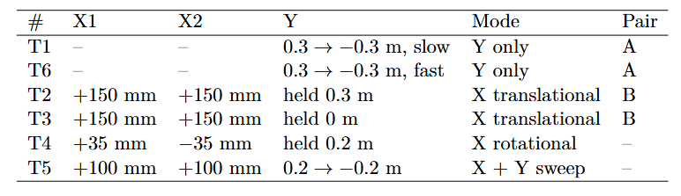
Simulation
Multiple Trajectories
Notes:
How theta is defined, difference
Max formula was 72 mm

Slide 13
Simulation
Multiple Trajectories
Noiseless data
No multisine injected
Notes:
How theta is defined, difference
Max formula was 72 mm

Slide 14
Simulation
Channel normalization
Previously one global sigma per channel:
  Sigma: per-channel std of X1, X2, Y pooled over all 6 trajectories
  Loss: MSE((q1_sim − q1_meas) / σ), normalizing X1, X2, Y to equal weight
New method (no results):
  Normalize per trajectory instead of one global
  So sigma[T1] = [σ_T1_X1, σ_T1_X2, σ_T1_Y]
    Each segment uses its corresponding normalization
(q1 is the measured stage positions)

Slide 15
Simulation
Channel normalization
Feedback from TU/e supervisors to use global sigma instead
The loss should measure errors in a consistent matter across all trajectories
  The same physical error receives the same weight everywhere
  Per-trajectory normalization makes the same absolute error count differently in different experiments

Slide 16
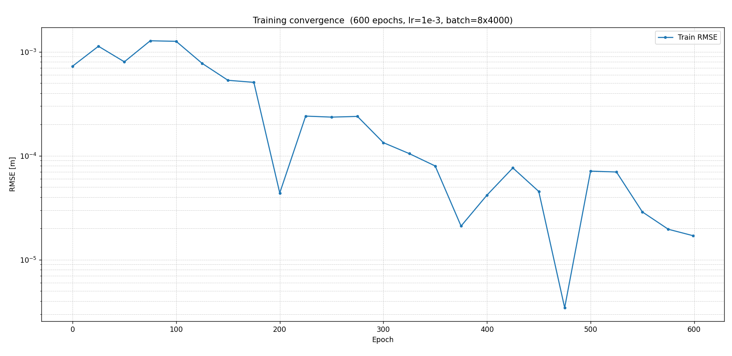

Slide 17
Overal RMSE 6.24e^-4 m
Over all 6 trajectories

Slide 18
Multiple trajectories with varying batches.
No full trajectories evaluation inbetween

Slide 19
Full trajectory evaluation
Instead every x amount of epochs run for all 6 trajectories full evaluation to determine convergence
  Schedule the learning rate based on evaluation
    Comment from Maarten: in his experience doesn’t benefit that much
Now the model exactly matches the generated data from the system
→ but in true setup should have train validation test set trajectories.
  Model selection: Use a fixed unseen validation trajectory set to evaluate/keep track of best parameters
Notes:
Can be done in parallel on the server (using a second GPU)
Currently no learning rate updates
Schedule the learning rate based on evaluation

Slide 20
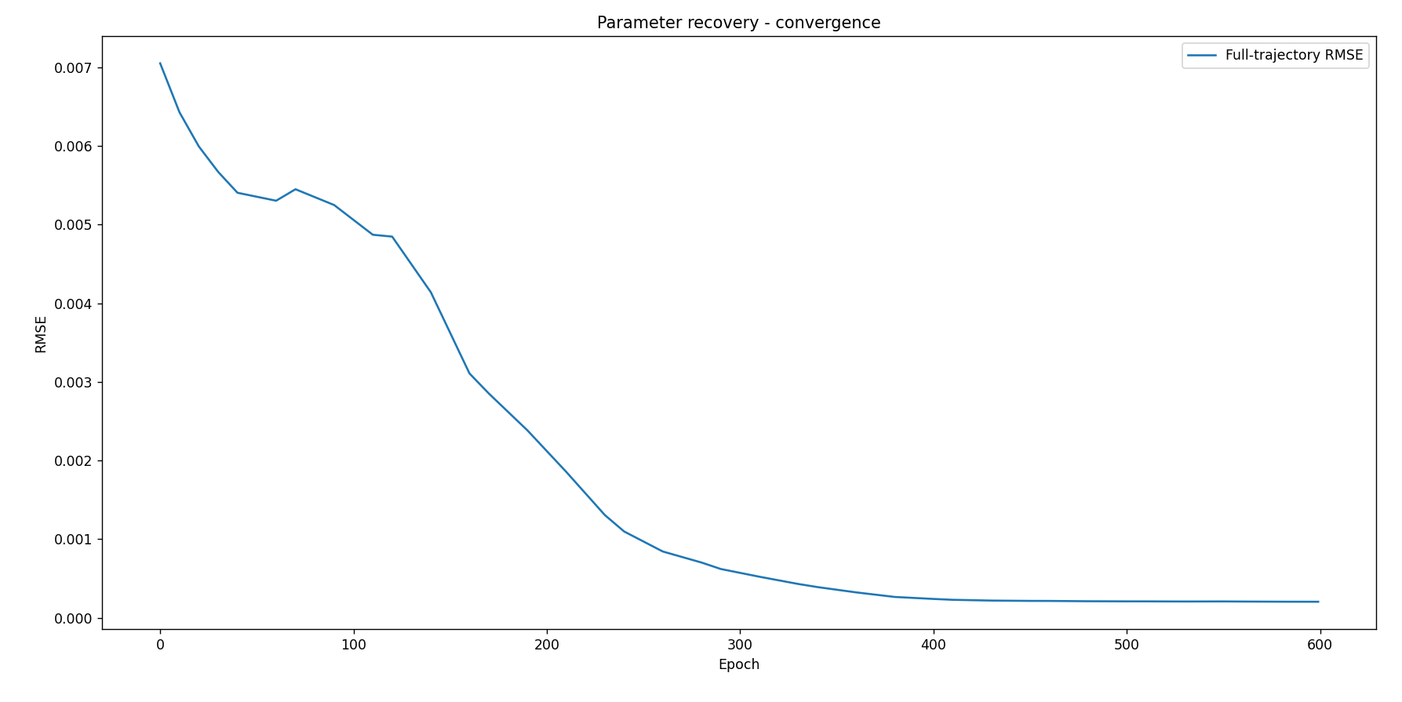
Convergence plot full trajectory evaluation

Slide 21
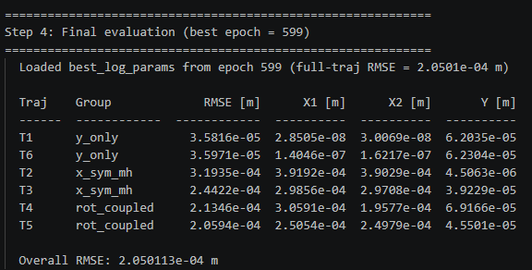

Slide 22
Note: best epoch is the final epoch, not fully converged

Slide 23
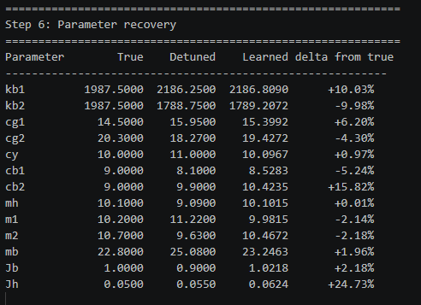
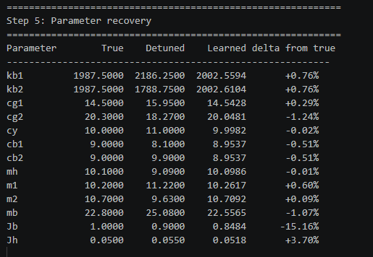
Notes:
Overal result is worse, but parameter recovery overall is better. But that’s mainly due to before one trajectory
Don’t clearly show per channel (X1, X2, and Y) currently

Slide 24
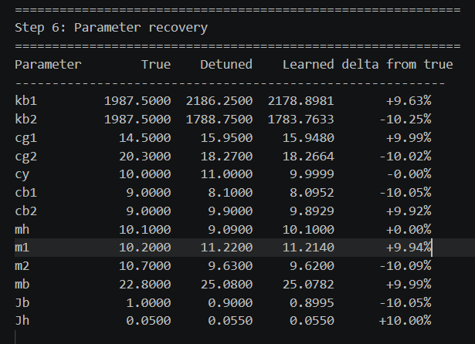
Multiple
One
Notes:
kb1 and kb2 are encouraged to be equal
cb1 and cb2 are encouraged to be equal
Jb and Jh are encouraged to change by the same fractional amount in log-space

Slide 25
Multiple
One
Multiple trajectories are able to identify more parameters. Previous trajectory was Y-only
Notes:
kb1 and kb2 are encouraged to be equal
cb1 and cb2 are encouraged to be equal
Jb and Jh are encouraged to change by the same fractional amount in log-space

Slide 26
Plot
plot output model tegen reference output
plot output model tegen reference output

Slide 27
Identifiability
Problem
The model dynamics only see the sums:
  MSE loss has no reason to prefer one combination over the other → flat direction in the loss landscape

Slide 28
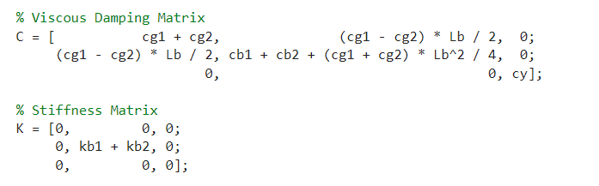
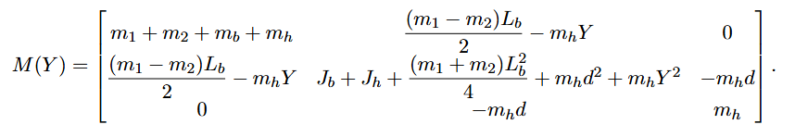
Identifiability
The model only sees:
  kb_sum = kb1 + kb2
  cb_sum = cb1 + cb2
  J_sum = Jb + Jh

Slide 29
Identifiability
The model only sees:
  kb_sum = kb1 + kb2
  cb_sum = cb1 + cb2
  J_sum = Jb + Jh

Slide 30
Identifiability
Solution
Added a small regularization gradient
kb1/kb2, cb1/cb2: normalized squared difference; prefers equal split.
Jb/Jh: log-space squared difference; prefers proportional fractional
Notes:
total gradient = MSE gradient + SPLIT_REG_WEIGHT * split_loss gradient
With SPLIT_REG_WEIGHT = 1e-2

Slide 31
Normalized squared difference
((kb1 - kb2) / (kb1 + kb2))**2
((cb1 - cb2) / (cb1 + cb2))**2
If kb1 == kb2, then:
penalty = 0

Slide 32
Log-space squared difference
relative change from the initial value
(log(Jb / Jb_init)- log(Jh / Jh_init))**2
So if Jb and Jh change by the same percentage, then:
Jb / Jb_init == Jh / Jh_init, then
Penalty = 0
Notes:
physical_param = params_init * exp(log_param)
Log parameterization so that the physical parameters cant become 0

Slide 33
Changed to print the summed parameters in the param recovery table, and print a separate table for the individual parameters for the summed params
  Not yet run
  Currently not looking at the gradient per parameter

Slide 34
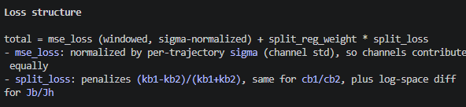
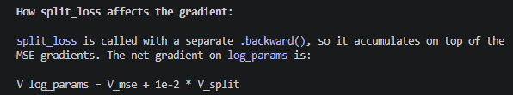
Identifiability
Sum kijken
Cost gelijk en jh groter

Slide 35
identifiability kijken puur sum identifiability kijken naar mini batches
Split loss
((kb1 - kb2) / (kb1 + kb2))^2
+ ((cb1 - cb2) / (cb1 + cb2))^2
+ (log_params[11] - log_params[12])^2
scaled by:
SPLIT_REG_WEIGHT = 1e-2
Notes:
mse_loss.backward()
split_reg.backward()
optimizer.step()

Slide 36
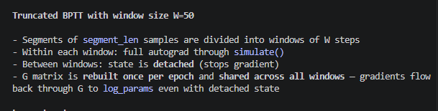
Code optimization

Slide 37
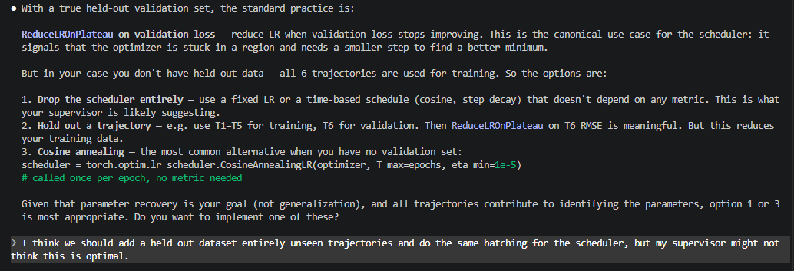
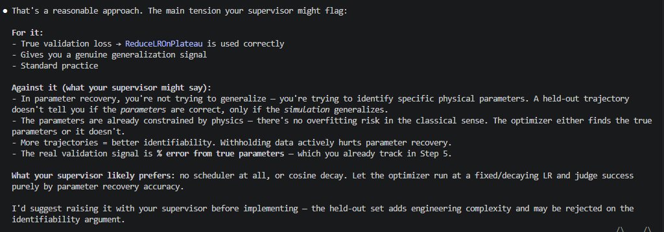
Good point about scheduling which Maarten recommended against

Slide 38
Convergence plot
Convergence plot is a bit biased against full trajectory, only 8 segments
  Else I should do for example every 100 epochs of the full trajectory else too expensive

Slide 39
Current problems
Problem 1 — Dormant channels included in the loss
- On T1/T6, X1 and X2 are suppressed by the feedback controller but contribute to the MSE
- The optimizer receives gradient from controller suppression dynamics, not plant physics
- Parameters are pulled toward values that explain controller behaviour, not physical
parameters
Problem 2 — Global sigma dilutes Y, inflates X
- sigma[Y] is computed from all 6 trajectories including T2/T3/T4 where Y is constant →
sigma[Y] is artificially small → Y is over-weighted in the loss
- sigma[X1] is computed from all 6 trajectories including T1/T6 where X1 is near-zero →
sigma[X1] is artificially large → X1 is under-weighted on trajectories where it is actually
active
Problem 3 — Within-trajectory amplitude imbalance
- On T5 (X + Y both active), if Y sweeps much more than X1/X2, Y dominates the loss
- Parameters primarily identified by X motion (m1, m2, cg1, cg2) are undertrained relative
to Y-related parameters (mh, cy)
Problem 4 — Cross-trajectory amplitude imbalance
- Trajectories with the same active channels can have very different amplitudes (T1
conservative vs T6 aggressive Y sweep)
- Global sigma cannot capture this: T6 segments always dominate T1 segments in the loss even
though both are Y-only
Problem 5 — Denominator is inconsistent across segments
- Different segments have different numbers of active channels (T1: 1 active, T2: 2 active,
T5: 3 active)
- A fixed denominator gives unequal weight per active channel-step across trajectory groups
- No single global denominator is correct for all segments simultaneously
Problem 6 — Adam sees inconsistent loss scale across batches
- Batch composition varies (different mixes of trajectory groups)
- Without per-segment normalization, the loss magnitude depends on which groups appear in
the batch
- Adam's second moment estimate v_t cannot stabilize → learning rate adaptation is
unreliable

Slide 40
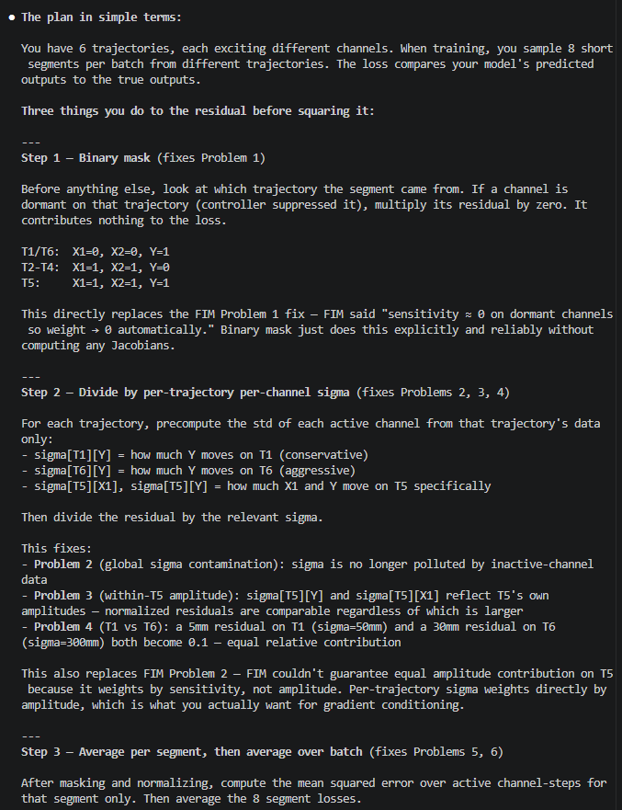
Stepwise solution

Slide 41
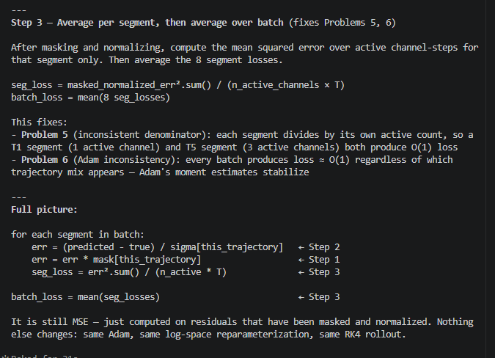

Slide 42
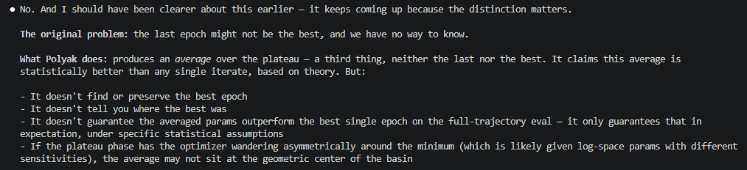
Polyak-Ruppert iterate averaging
ReduceLROnPlateau.
Mainly useful when noise dominates.

Slide 43
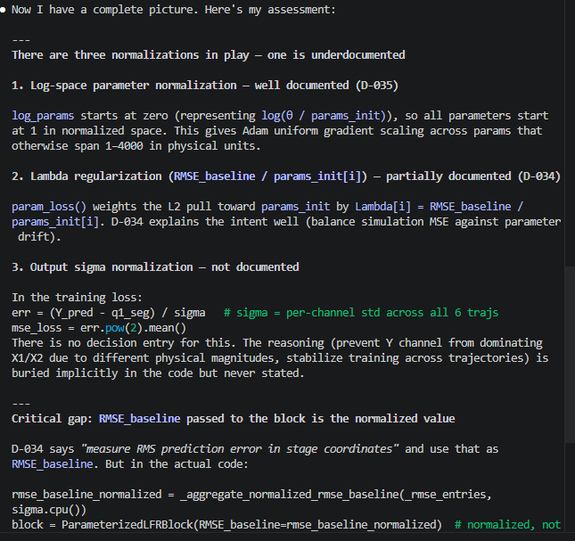
Normalizations

Slide 44
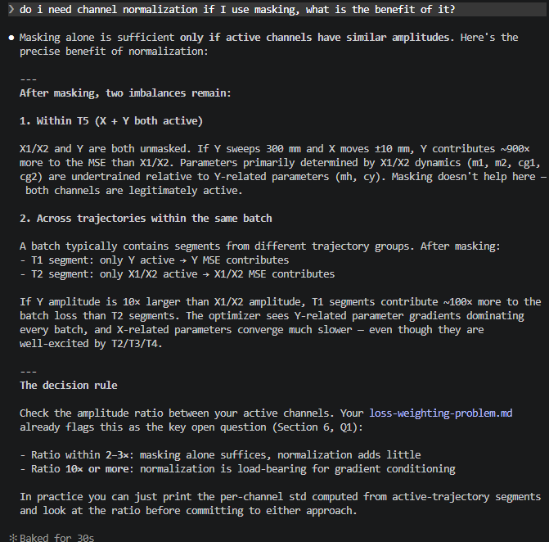
Purpose of normalization

Slide 45
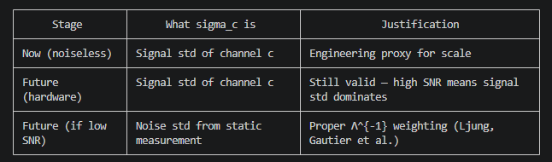
Future proof for noise

Slide 46
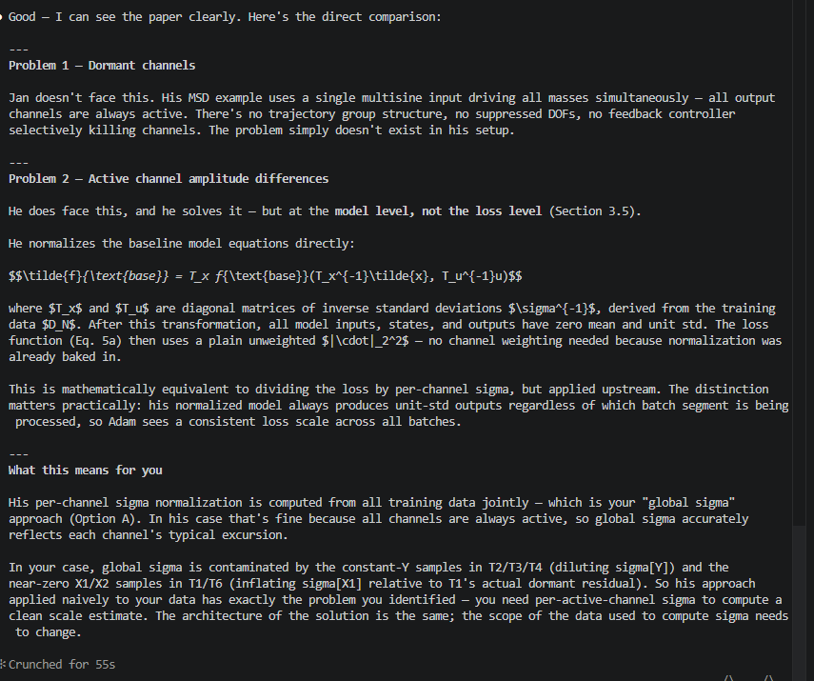
How Jan faces normalization problem

Slide 47
Fisher Information Matrix
Problem different channels should be set to 0 for
How to combine with normalization??
1. Computed at detuned initialization
2. Could recompute periodically
3. Augmentation adds cost

Slide 48
Question 1
For the additional state in simulation, should the added state be physically interpretable from ASMPT’s perspective, or is it sufficient to demonstrate the concept of recovering an unmodelled latent state from data?

Slide 49
Question 1
Ik had een vraag over het toevoegen van de additional state. Heeft het vanuit ASMPT meerwaarde als de additional state een fysische betekenis heeft, puur voor simulatie?
Of is het voldoende als ik het alleen als een "proof of concept" heb voor het recoveren van deze toegevoegde state?
But at that point I could also have used the simscape model with coulomb friction, or do I need to add the coulomb friction
Validate additional state with simscape

Slide 50
Question 2
What frequency range should the model accurately be able to capture?
Notes:
Is this bandwidth already known from system requirements, controller bandwidth, or measurement data?

Slide 51
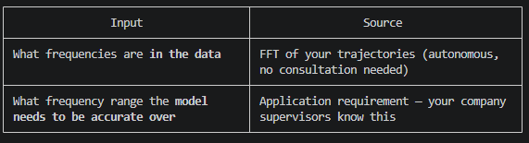
Question 2
What sampling rate does the model need to work?
4 khz maybe already enough? Current simulated system data is at 20 khz like the system, but for the model…
"ASMPT: over what range of frequency do you want to have a good model"

Slide 52
Outline next week
Simulation ensure proper identification for parameter recovery
  Determine sampling length
  Compare current trajectories with García’s
  Multisine for identification to the trajectories

Slide 53
Joint meeting TU/e
Wednesday 13th of may afternoon time?

Slide 54
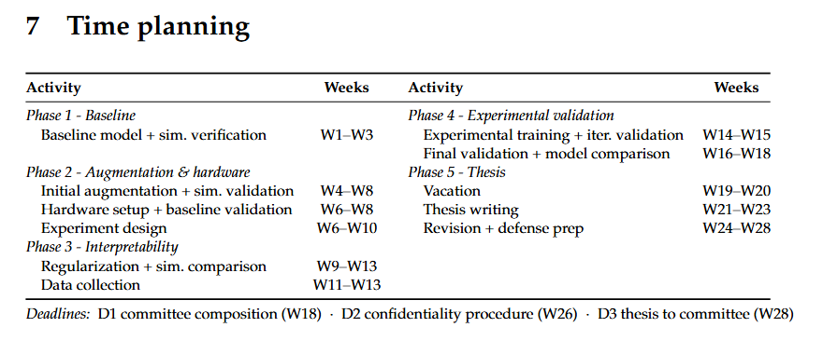
Planning – Week 5

Slide 55
Planning – Week 5

